Slide 1
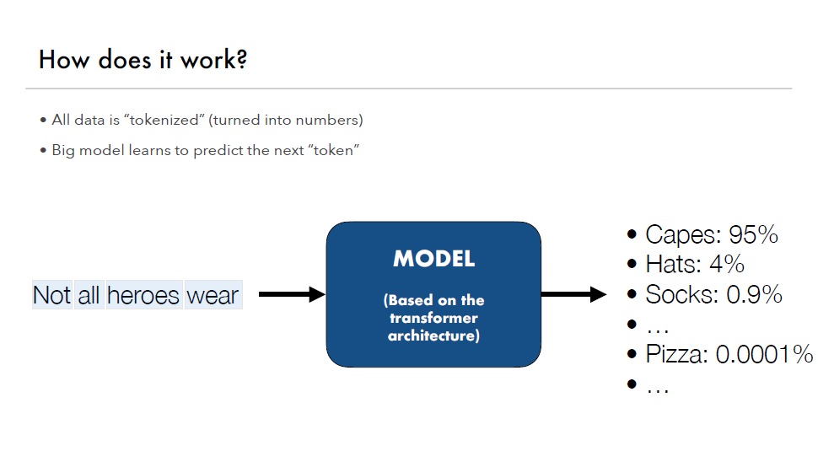

Slide 2
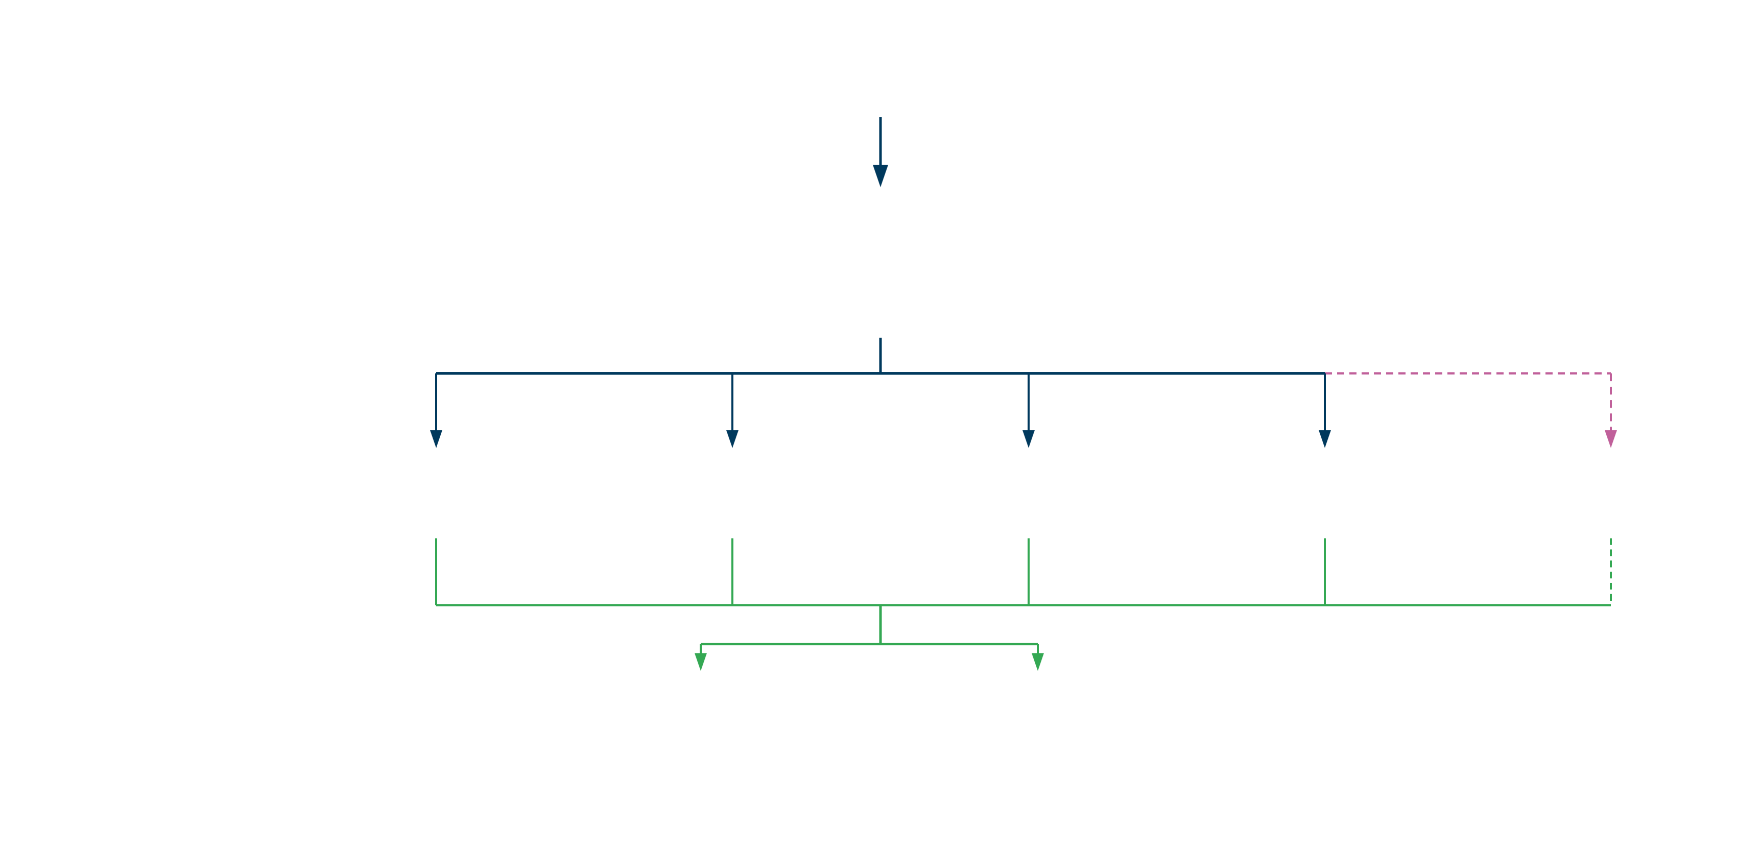
PROOF OF CONCEPT · PROCESS ARCHITECTURE
PROOF OF CONCEPT – Pricing Engine Investigation Workflow
INPUT
User Input + QA Log Upload
LEGEND
Trade · Market · Model · Results Data
AI (LLM) — reasoning, summarization, comparison
Deterministic — structured parsing, rule-based processing
CORE
POC Core
BCP Cloud Hosted Service
Parses logs and structures data
Pre-defined orchestration
ANALYSIS
Market Summary
Model Summary
Risk Summary
Trade Summary
Diff Summary
AI (LLM reasoning)
AI (LLM reasoning)
AI (LLM reasoning)
AI (LLM reasoning)
If two logs uploaded
AI (LLM comparison)
QuantBot
QA Wiki query (AI LLM)
FINAL OUTPUT
Final Summary
Excel Output
Narrative report
Structured data export
AI-generated (LLM)
Deterministic
Note: AI-driven investigation layer on top of pricing engine outputs
CONFIDENTIAL

Slide 3








AI CAPABILITY FRAMEWORK · PRICING & RISK TECHNOLOGY
Where AI (LLM) Adds Value in Pricing Investigations
AREA
✓ WHAT OPUS 4.6 CAN DO
✗ WHAT IT CANNOT RELIABLY DO
Data Analysis
Analyze large financial datasets, logs, and spreadsheets
—
Investigation
Suggest likely causes of discrepancies
Prove the root cause numerically
Comparison
Compare systems / runs and highlight differences
Guarantee exact reconciliation
Reasoning
Perform multi-step financial reasoning
Ensure deterministic correctness
Explanation
Generate clear summaries for traders and stakeholders
—
Cashflows
Understand cashflow logic conceptually
Generate exact payment schedules
Pricing / Greeks
Reason about drivers of PV changes
Compute exact PV, Delta, or Vega
Source of Truth
Assist and accelerate the investigation process
Replace a validated pricing engine
Guiding principle: Use AI for investigation and explanation — not for deterministic pricing calculations
CONFIDENTIAL

Slide 4
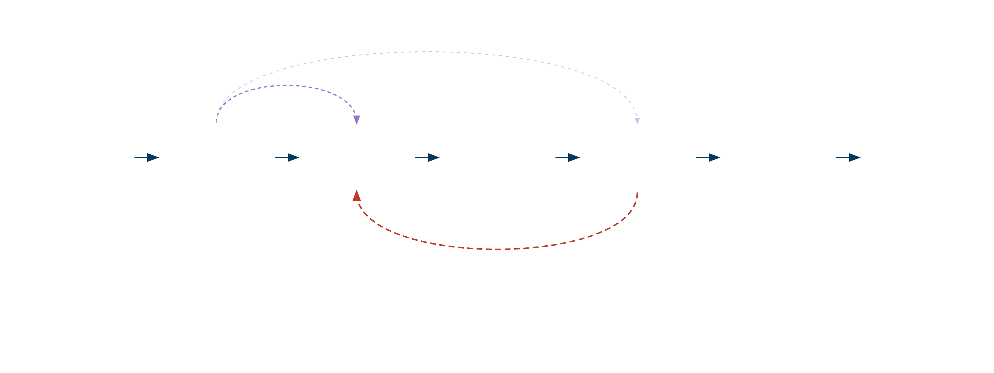
POC · TARGET ARCHITECTURE
POC Target State: Agentic Validation Workflow
CURRENT STATE
Logs + User Input
Log Parser Tool
LLM Explain
AI Explanation
QA input data
Structures Data
Synthesize
Findings
Excel report
TARGET STATE
same agent / decision layer
choose tool
Logs + User Input
Agentic AI
Tools & Checkers
Evidence
(Deterministic)
Agentic Review
LLM Explain
plans and selects checks
Validates evidence
decides next step
Synthesize
Findings
Explanation
QA input data
deterministic validators
validated report
If evidence incomplete → run next check
Principle: AI decides what to check — tools provide proof
CONFIDENTIAL

Slide 5
POC · TARGET ARCHITECTURE
POC Current State: Step by Step Workflow
choose tool
same agent / decision layer
If evidence incomplete → run next check
Logs + User Input
Log Parser Tool
LLM Explain
AI Explanation
QA input data
Structures Data
Synthesize
Findings
Excel report
Principle: AI decides what to check — tools provide proof
CONFIDENTIAL

Slide 6
POC · TARGET ARCHITECTURE
POC Target State: Agentic Validation Workflow
same agent / decision layer
choose tool
Logs + User Input
Agentic AI
Tools & Checkers
Agentic Review
LLM Explain
plans and selects checks
Evidence
Validates evidence
decides next step
Synthesize
Findings
Explanation
QA input data
deterministic validators
validated report
If evidence incomplete → run next check
Principle: AI decides what to check — tools provide proof
CONFIDENTIAL

